Slide 1


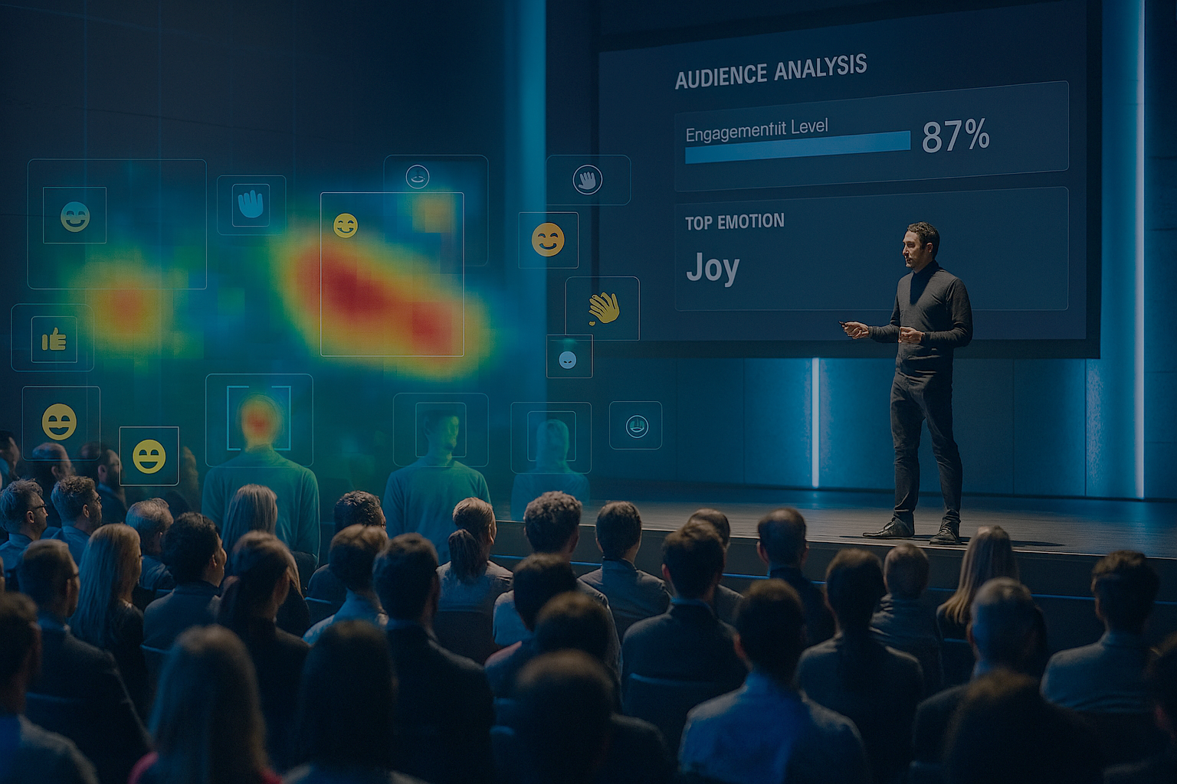
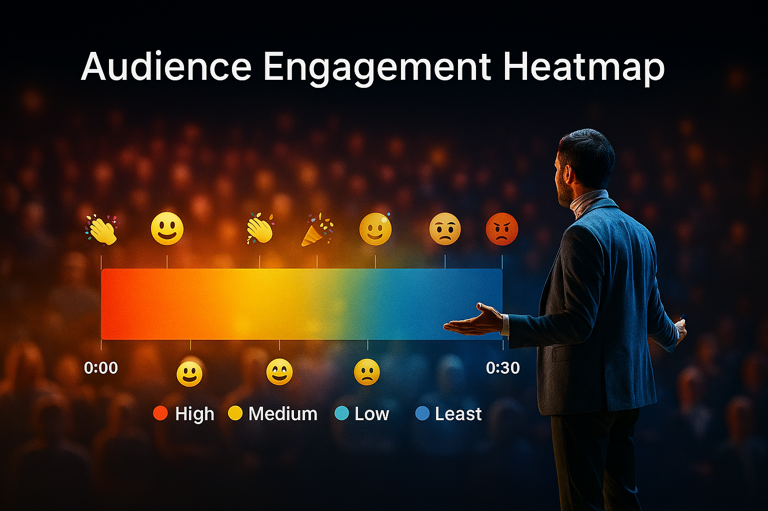
AI Audience Pulse
BaselHack 2025
Freestyle Challenge Team “ThumbsUp”
Resonance Radar

Slide 2
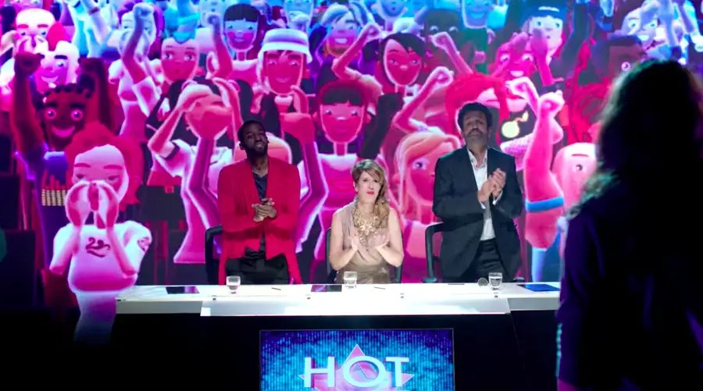
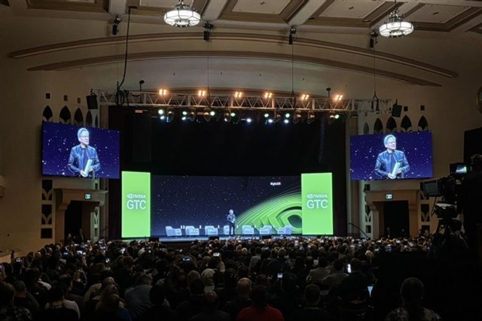

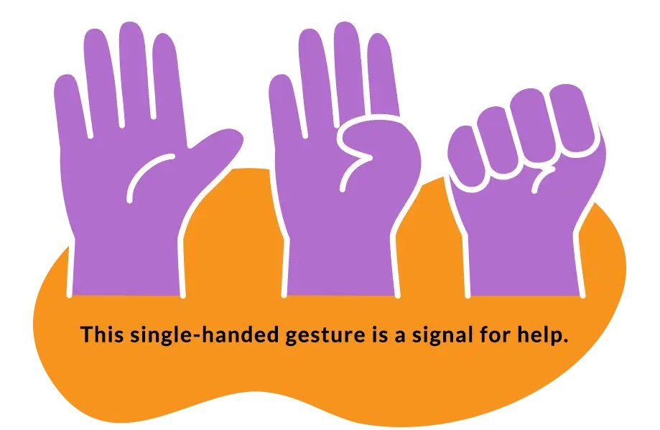
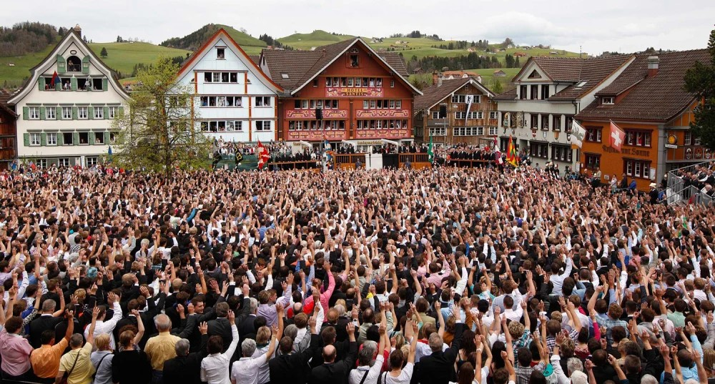
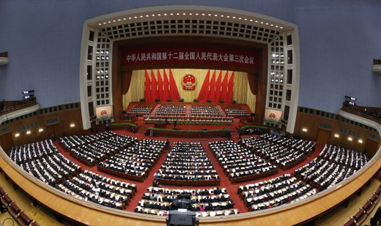

Slide 3
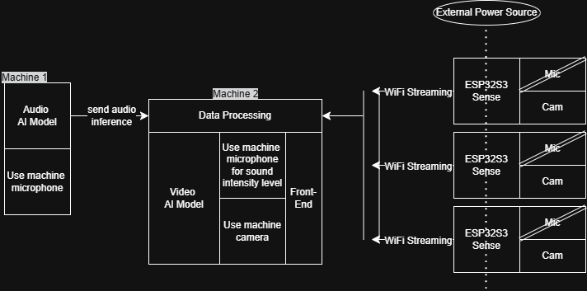
Architecture
"Dieses Foto" von Unbekannter Autor ist lizenziert gemäß CC BY

Slide 4
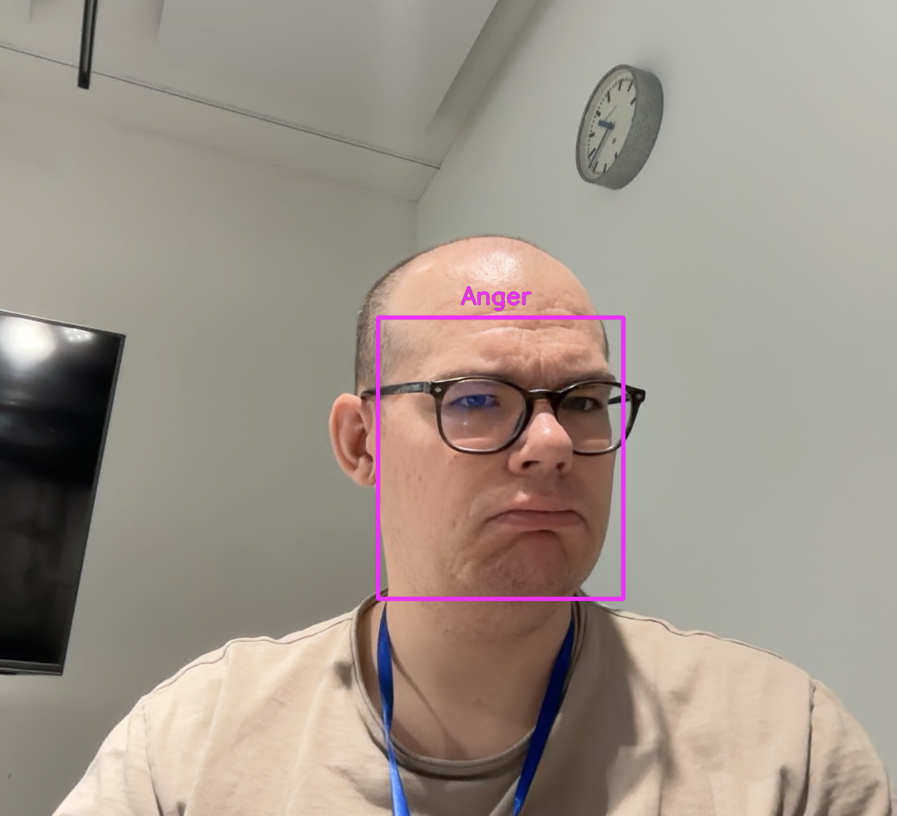
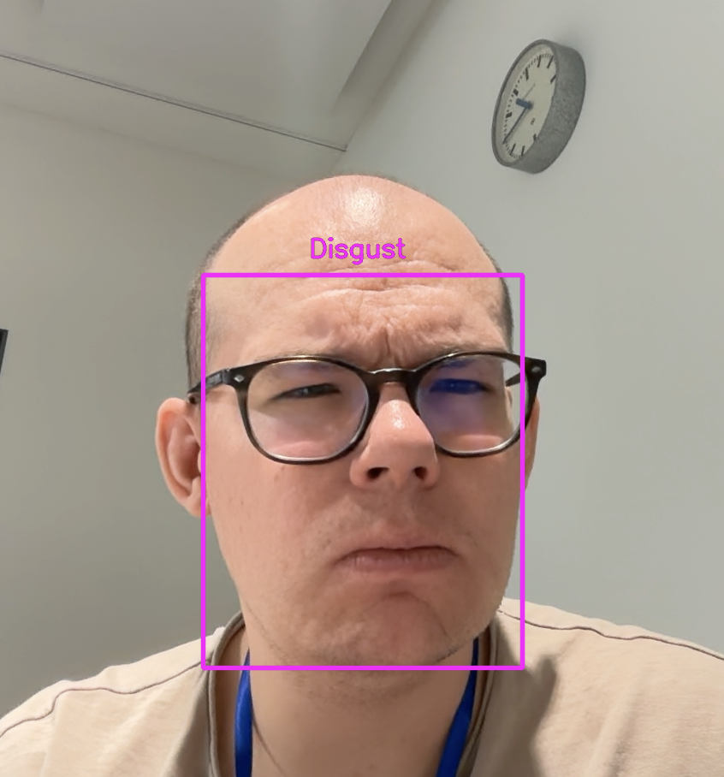
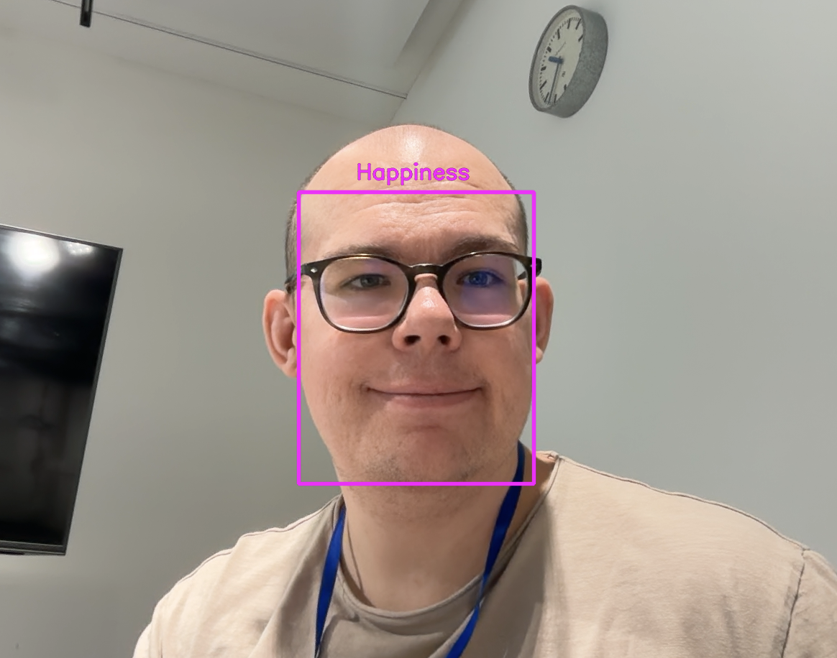

Additional Features
Gamification-Ready Template
Advanced AI Model for Face and Emotion Recognition A comprehensive model capable of high-accuracy detection and emotion analysis. ⚠️ Requires more powerful hardware than used in the demo setup
Product Roadmap
Integrate Face Recognition with higher quality hardware,
Enhance Audio Processing,
Reduce input latency
…
"Dieses Foto" von Unbekannter Autor ist lizenziert gemäß CC BY-SA

